Slide 1
SCA RESOURCE MANAGEMENT SYSTEM
By Mohit Kumar Raj Badi
Roll no: 1775018

Slide 2
INTRODUCTION
SCA Study Resource Management System is a software application which allows a particular Educational Institute or Training Center to arrange, conduct and manage study resource via online which can be accessed by the students and faculty will get less burden.
SCA Study Resource Management System is very useful for Educational Institute to store the study resources, safe the time of the students and the faculty as well. It will help the Institute and there students and faculty as well.

Slide 3
OBJECTIVES
The effective use of "SCA Study Resource Management System", any Educational Institute or training centers can be use it to put all the study resource online that can be accessed by the user anytime and anywhere.
To deal with On-line Study System in an easy way and an efficient mannered (connection process).
Specify a privilege for each person to allow each person use this system in a specific purpose and for security concern too.
Create strong and secrete data base that allow for any connection in a secret way, to prevent any outside or inside attacks.

Slide 4
scope
SCA Study Resource Management System is designed for Educational Institutes (like schools, universities, training centers).
The system handles all the operations for different users like viewing, adding, deleting, and editing.
The type of files can be uploaded by the admin and the faculty are pdf, doc, docx, pptx and ppt.
Providing security of the account.
Can be accessed anytime and anywhere from any cross platform devices too.
Reducing the burden and overhead work from the faculty and the students as well.

Slide 5
Project category
It is a web based application
Unlike other traditional applications , It is accessible anytime , anywhere , via a PC or Mobile devices with an Internet Connection
It need lower requirements on the end user system and simplified architecture.

Slide 6
Tools and platform
Operating system: WINDOWS 10
Front End Software: HTML, CSS, BOOTSTRAP, JQUERY, AJAX
Back End Software: PHP,MySQL
Tools Used: XAMPP, SUBLIME TEXT EDITOR

Slide 7
Hardware and software requirements
It needs most recent and stable version any web browser like Google Chrome, Firefox , Internet Explorer , Safari or others.
Hardware requirement:
Intel Pentium 4 or more
1 GB of RAM.
Minimum 1024x768 screen resolution with Highest (32 bit) colors.
OS: Windows(XP,7,8,10),Mac OS, Linux , Unix , iOS , Android and others.
Internet Connection with good speed.

Slide 8
Working of sca study resource management system:

Slide 9
Function requirements and specification
Functionality wise:
Authenticate Module: Sign in/Login and Sign out/Log out.
Manage user Account: Profile can be edited.
Manage Study Files: Faculty can upload their subject study files. Admin can also manage the study files.
Manage Question Paper Files: Admin can manage the question paper for the use of the students.
File View Module: In this module the student after the login get access the study which now can be used by the students.
Searching Module: Search module provides search of files by the students.

Slide 10
User wise:
Admin:
Admin can view and approve or deny the Pending Approval of the Students.
Admin can view the Approved Students and can edit or delete their profile and can add student.
Admin can view the denied Students and can approve them or delete them form the database.
Admin can view , edit , add and delete a Faculty profiles.
Admin can view , edit , add and delete Subjects.
Admin can view the files uploaded , edit , add new and delete Files uploaded by the Faculty.
Admin can view , edit , add and delete the Exam Files.
Admin can view , edit , add and delete Admin profiles.
Admin can edit their Profiles as well.
Admin can change their password.

Slide 11
Faculty:
Faculty can upload their study materials files.
Faculty can view the files they uploaded.
Faculty can edit the files they have uploaded.
Faculty can delete files they have uploaded.
Faculty can edit their profile.
Faculty can change their password.
Student:
Student can view the study materials and use it.
Student can view the exam materials and use it.
Student can edit their profile.
Student can change their password.

Slide 12
Non-Functional requirements and Specification
Performance Requirements: System can withstand even though many no. of users requested the desired service. As we are keeping high level server of the SCA Study Resource Management System and access is given to the only registered users, it can withstand the load.
Safety & Reliability Requirements: By incorporating a robust and proven Database into the system, reliable performance and integrity of data is ensured. There must be a power backup for server system.
Security Requirements: Sensitive data is protected from unwanted access by user’s appropriate technology and implementing strict user-access criteria.
Software Quality Attributes: Menu-Driven Programs with user friendly interface with simply hyperlinks. It is very easy to use. Backup mechanisms are considered for maintainability of the software as well as database.

Slide 13
Control flow diagrams
Context Level:

Slide 14
1 Level DFD:

Slide 15
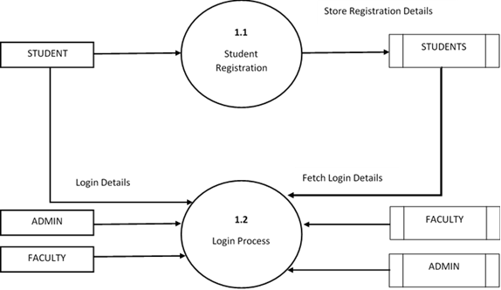
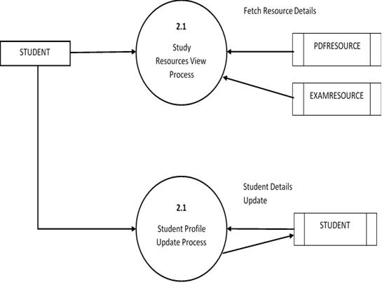
2 Level DFD:

Slide 16
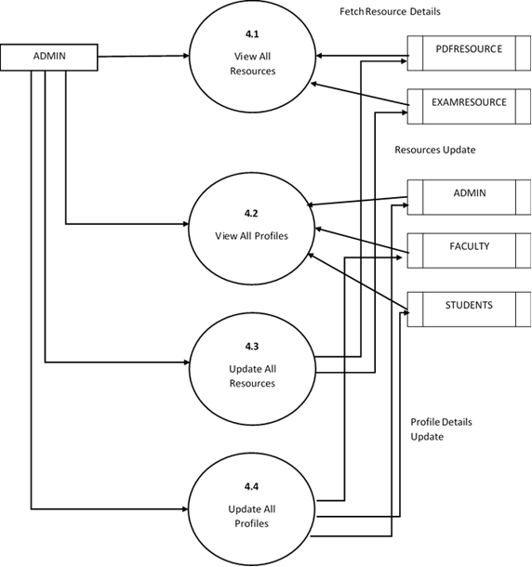

Slide 17
Er diagram

Slide 18
Database design
STUDENTS TABLE

Slide 19
FACULTY TABLE
ADMIN TABLE

Slide 20
SUBJECT TABLE
PDFFILE TABLE

Slide 21
EXAMFILE TABLE

Slide 22
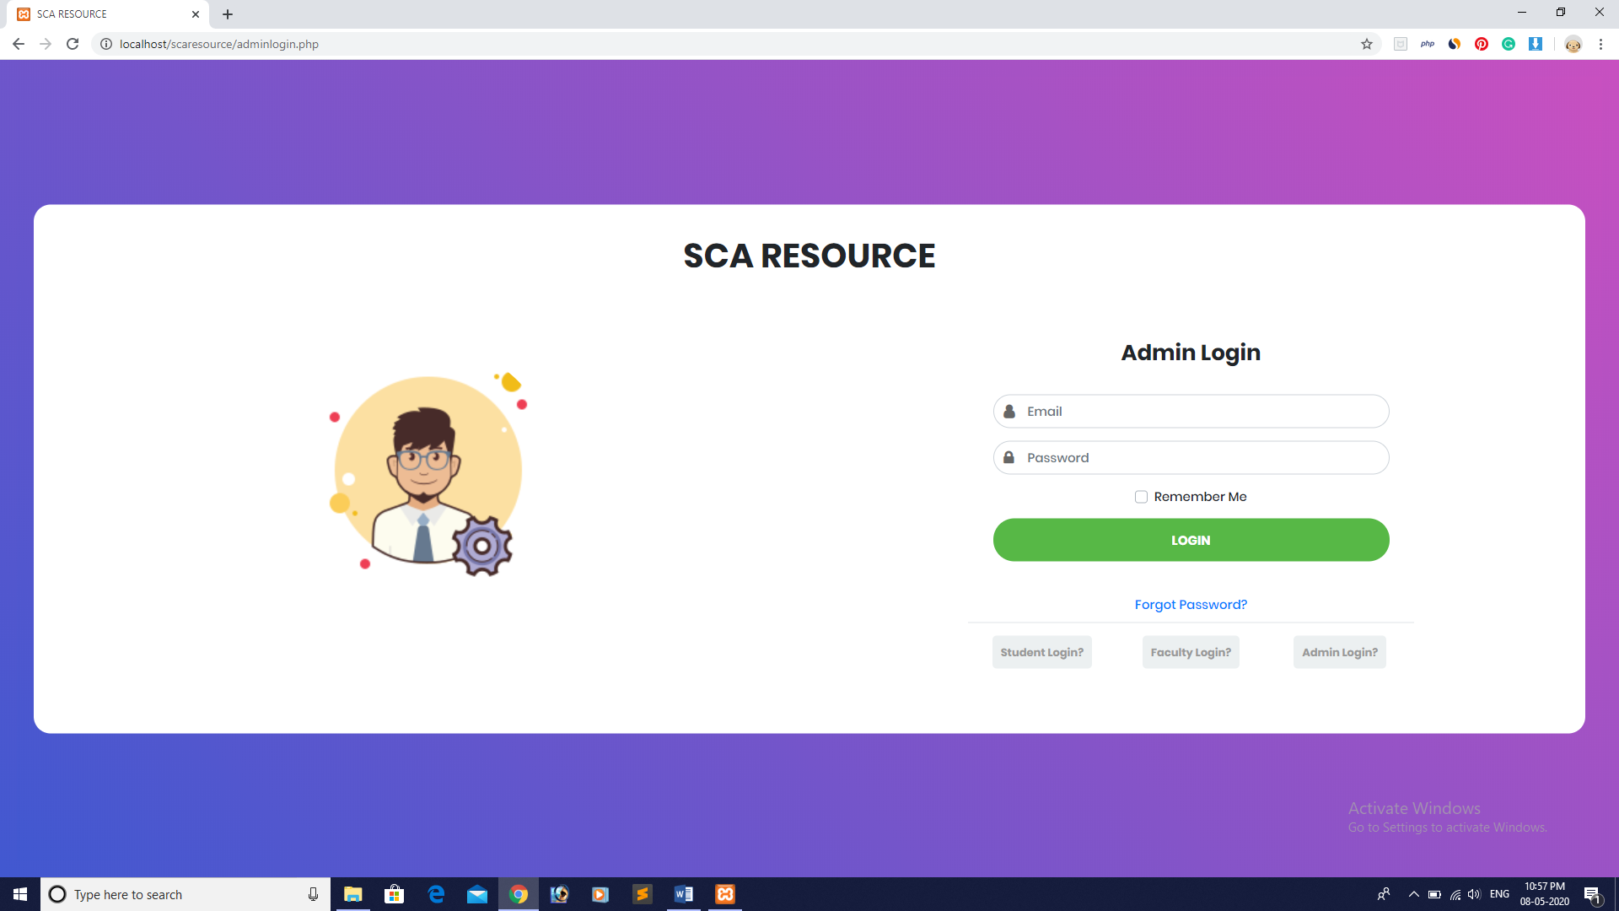
UI DESIGN AND SCREENSHOOTS:
User : Admin
Admin Login:

Slide 23
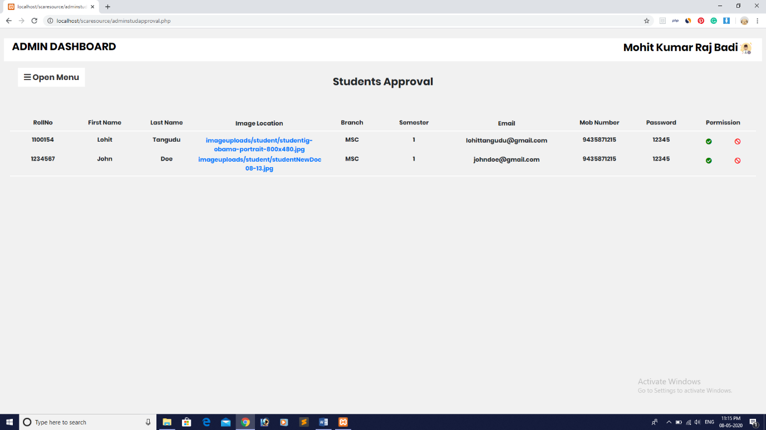
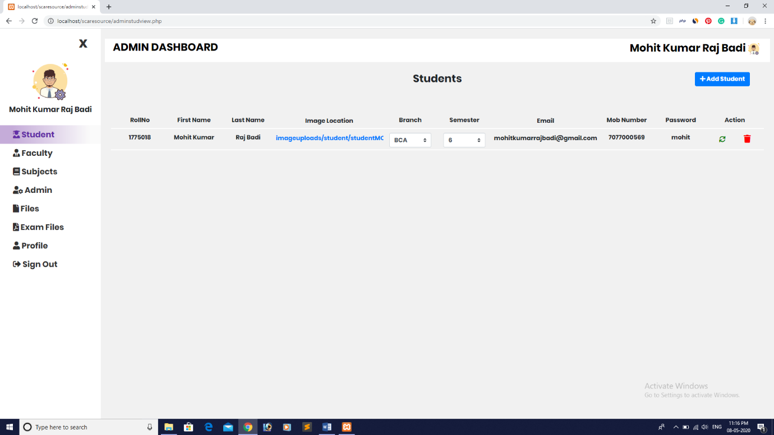
Manage the Students Approval:
Manage the Students:

Slide 24
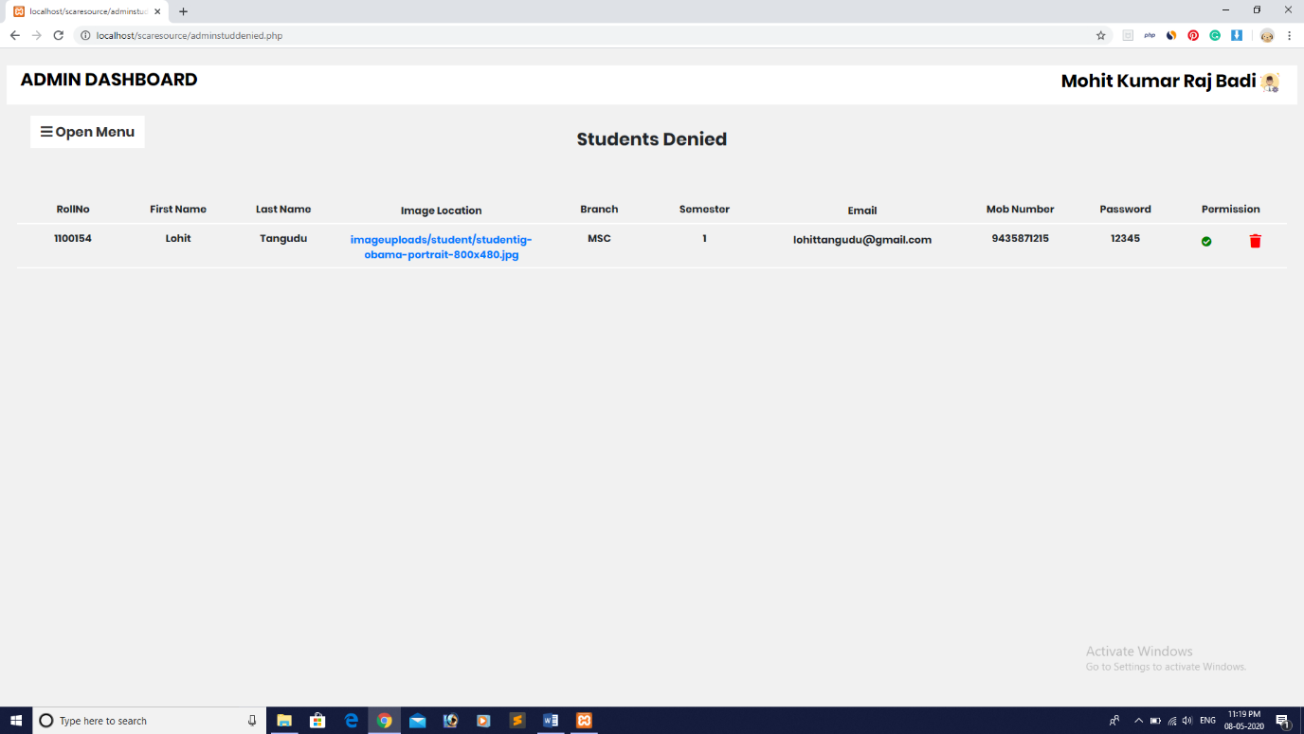
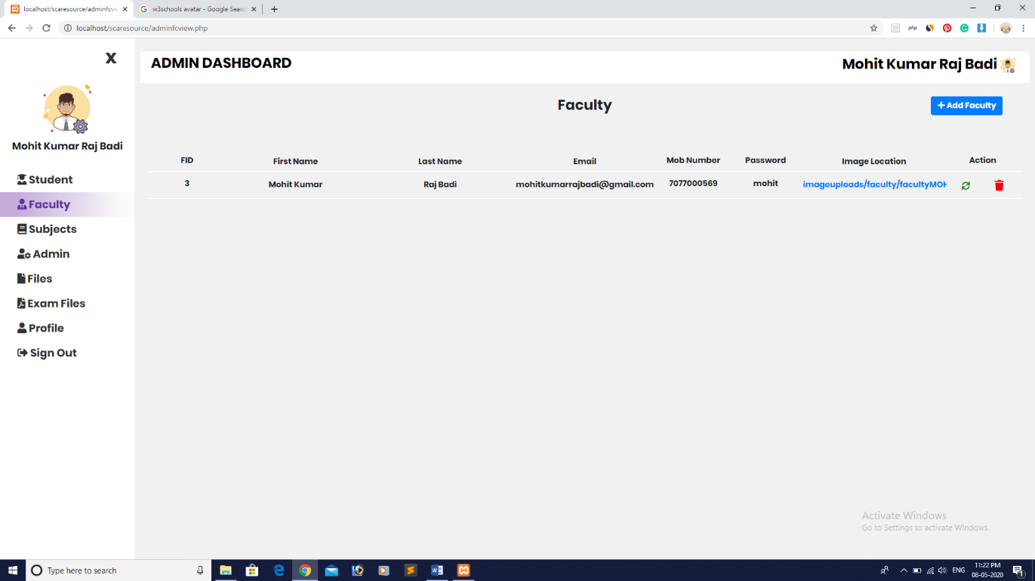
Manage the Students Denied:
Manage the Faculty:
Manage the Faculty:

Slide 25
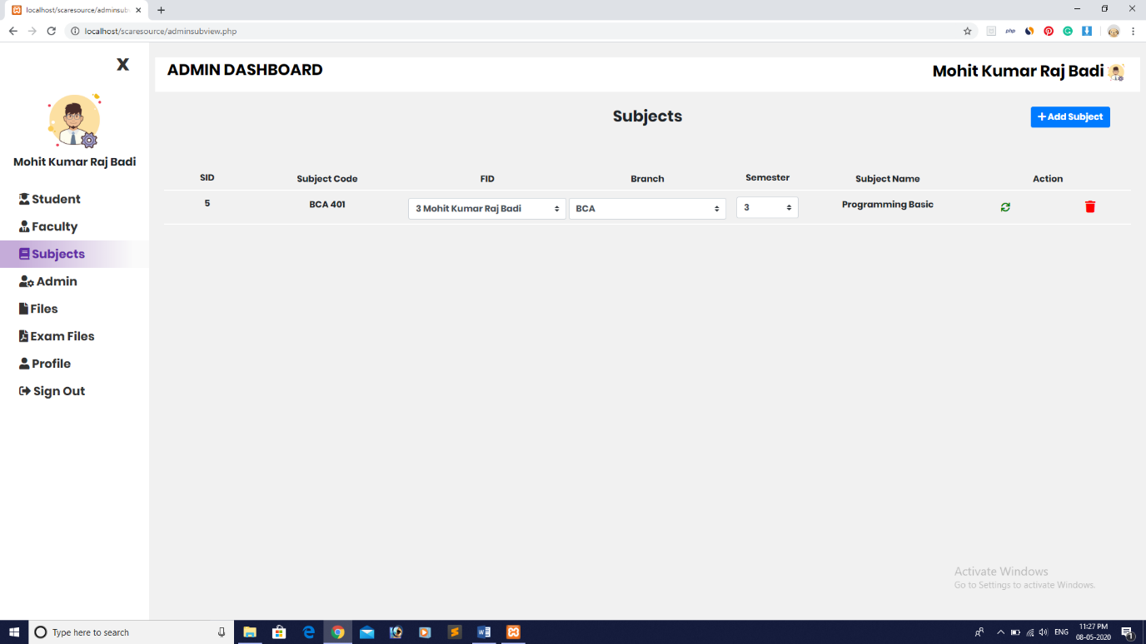
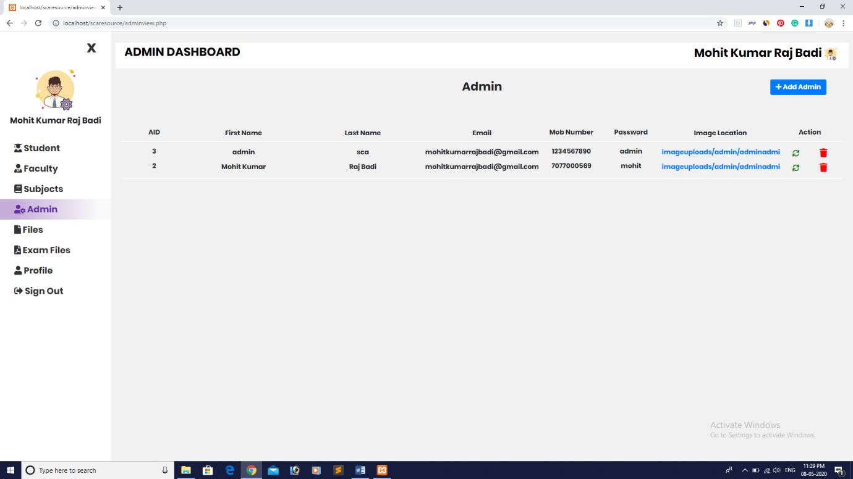
Manage the Subjects:
Manage the Admin:

Slide 26

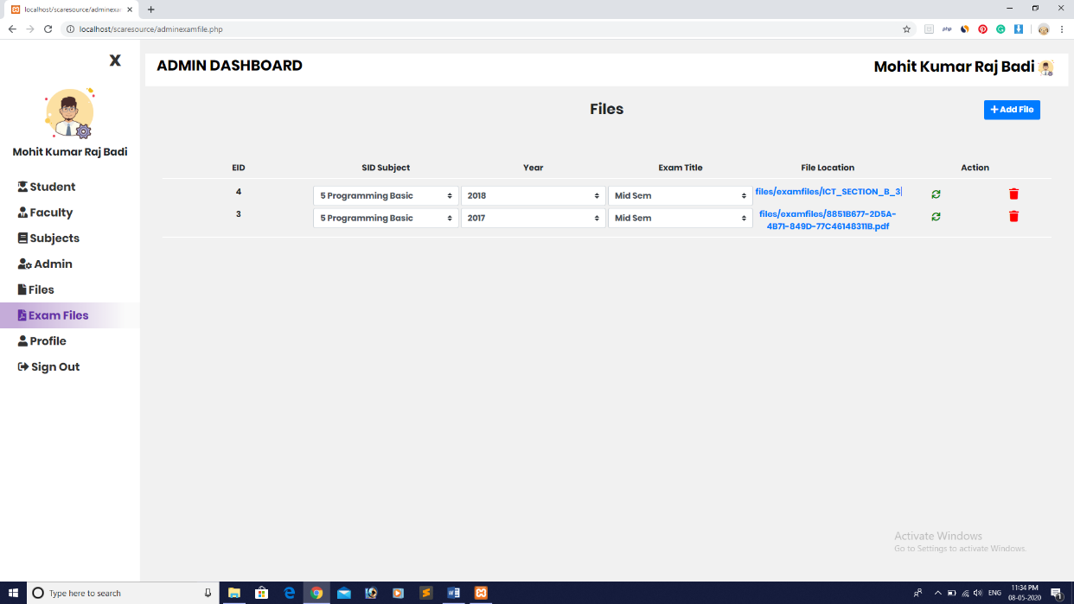
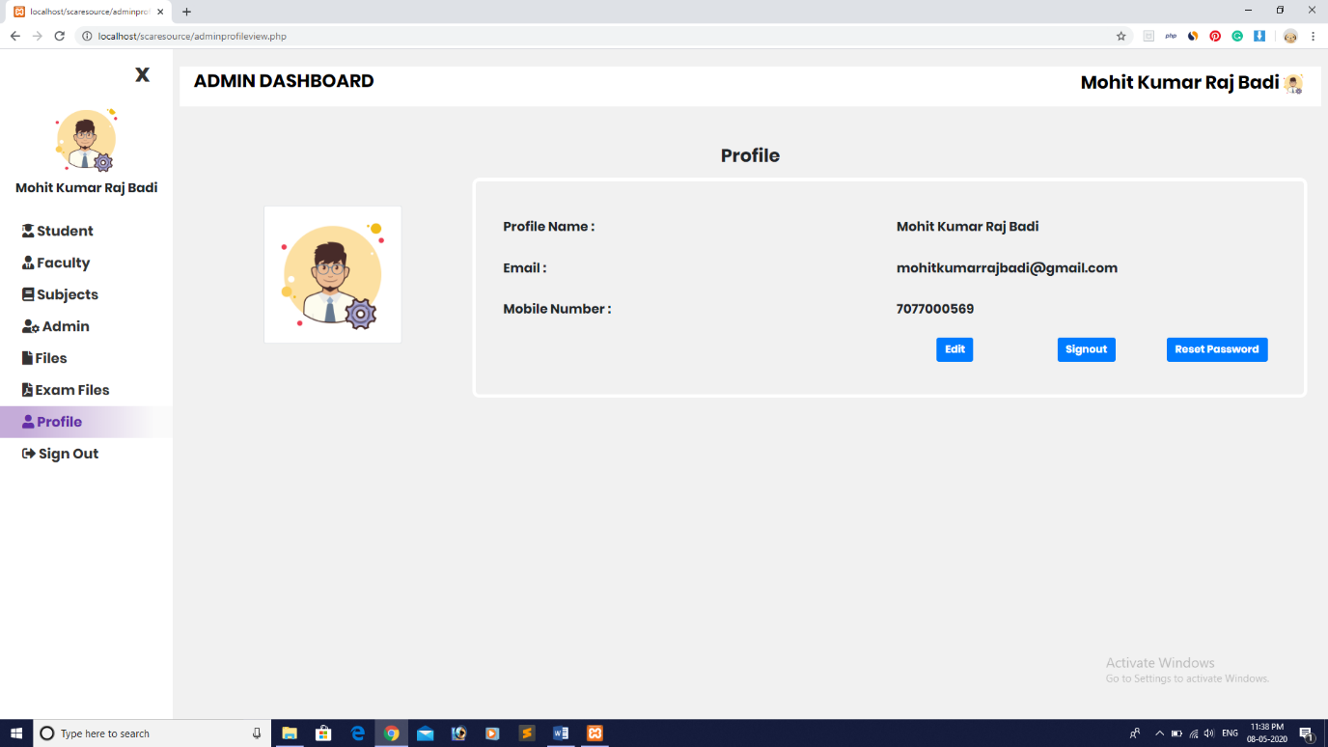
Manage the Files uploaded by the Faculty:
Manage the Exam Files:
Manage own Profile:

Slide 27
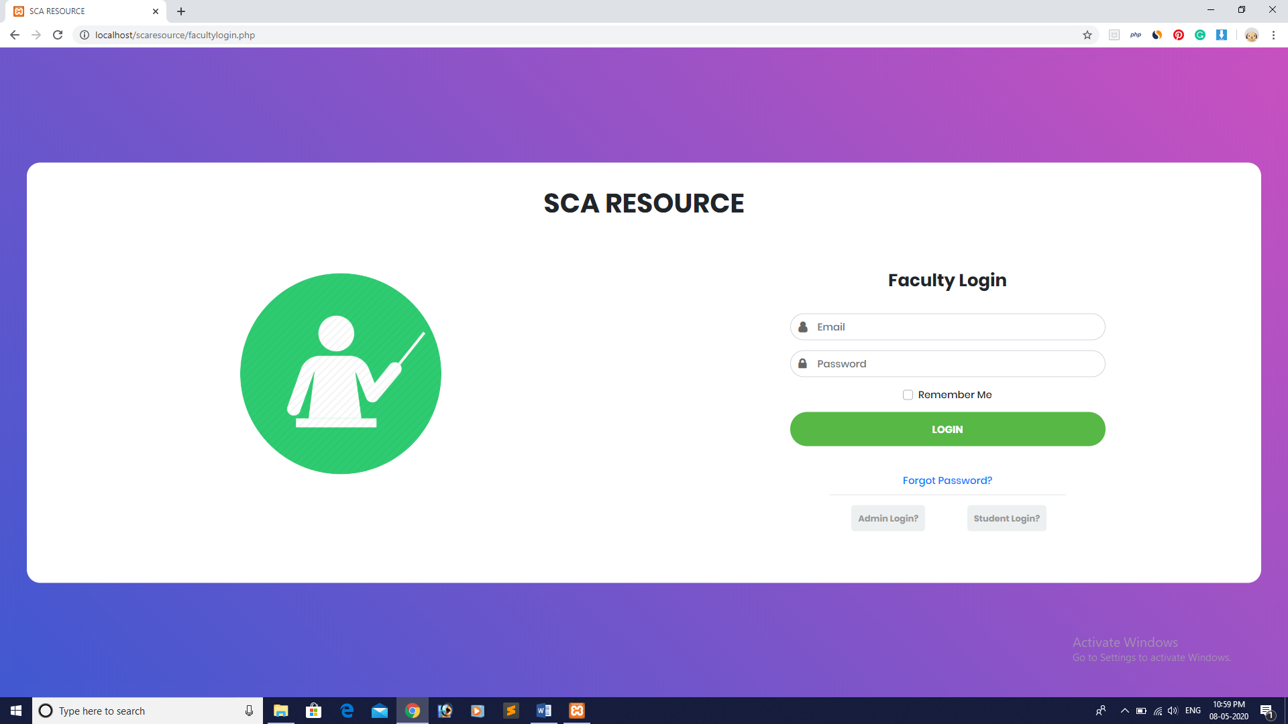
User : Faculty
Faculty Login Page:

Slide 28
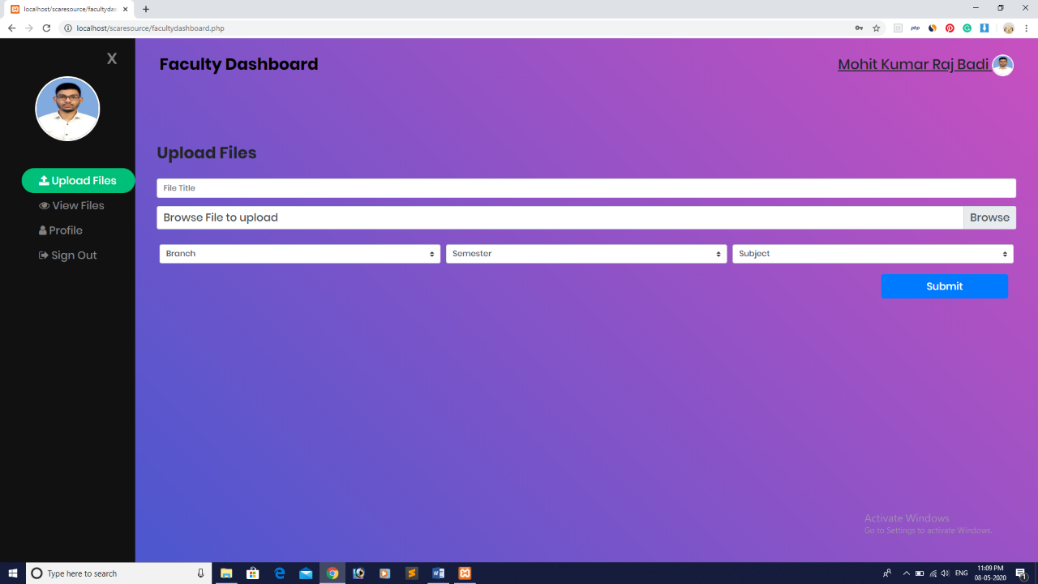
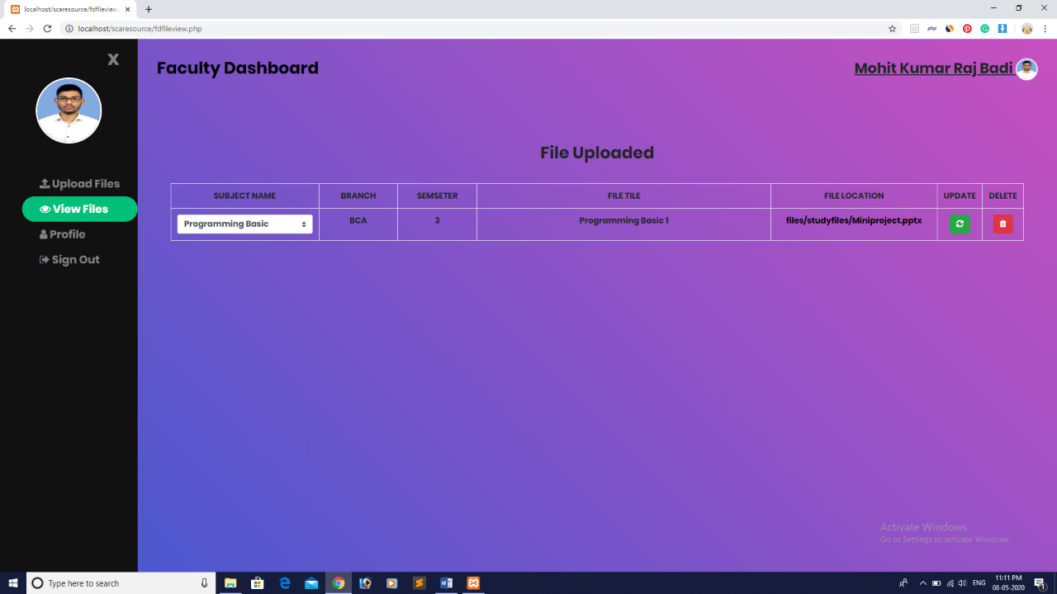
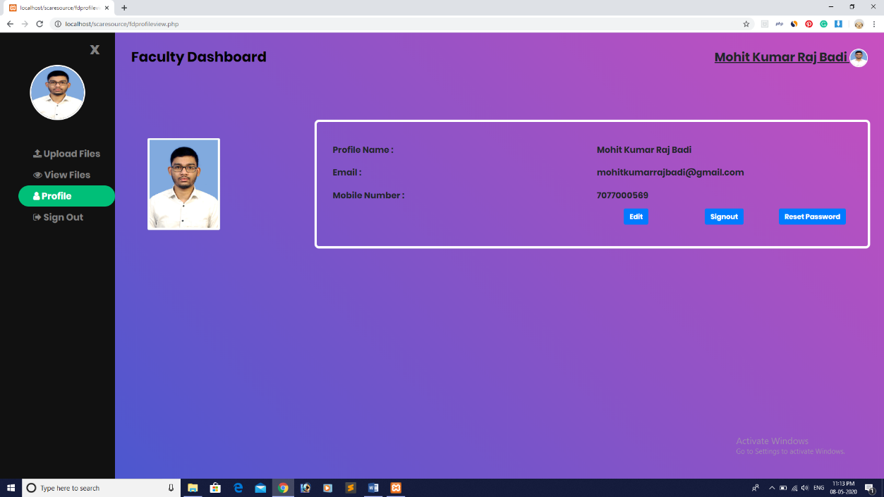
Upload the Files / Study resources:
Manage the Files:
Manage own Profile:

Slide 29
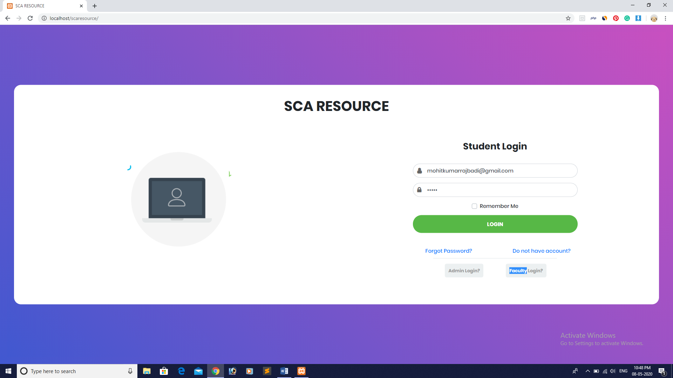
User : Student
Student Login Page:

Slide 30
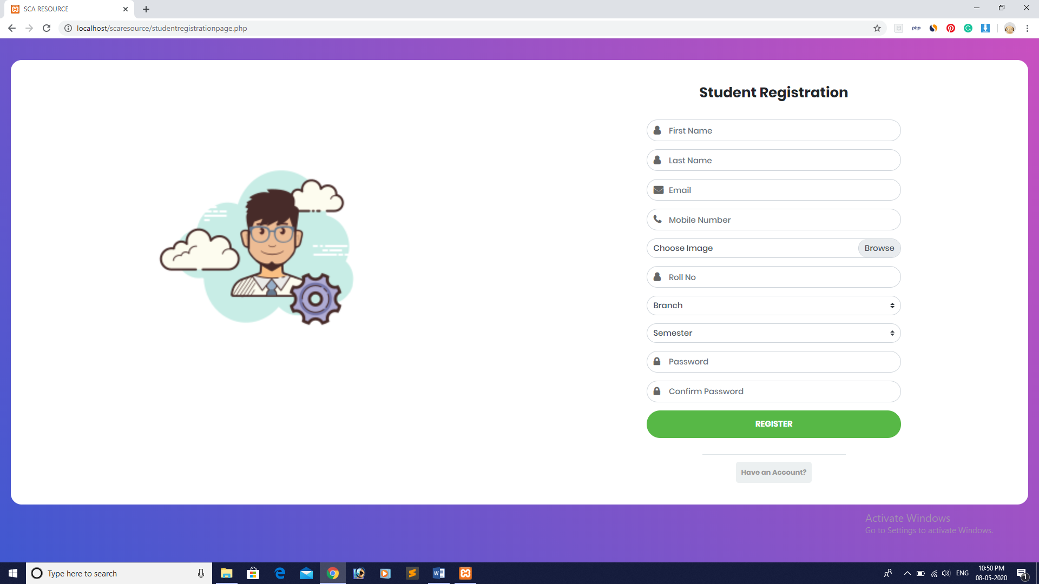
Student Registration Page:

Slide 31
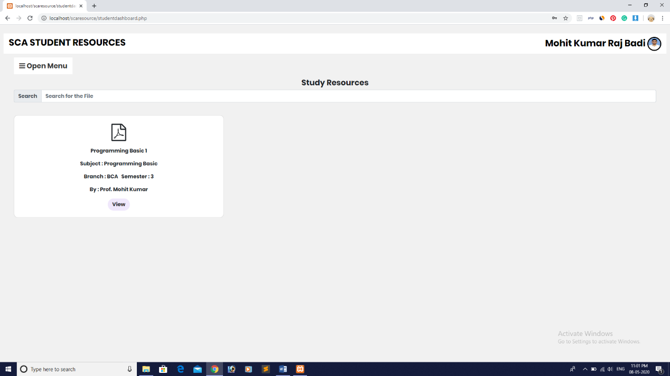
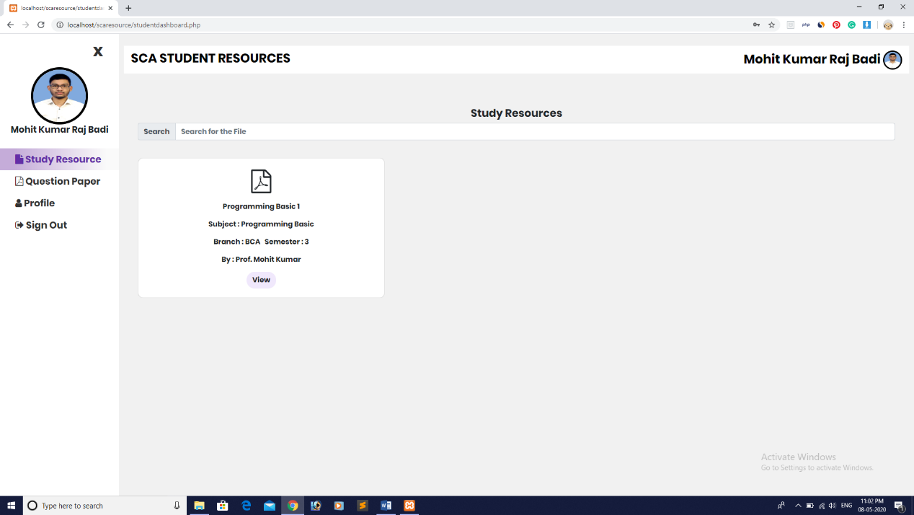
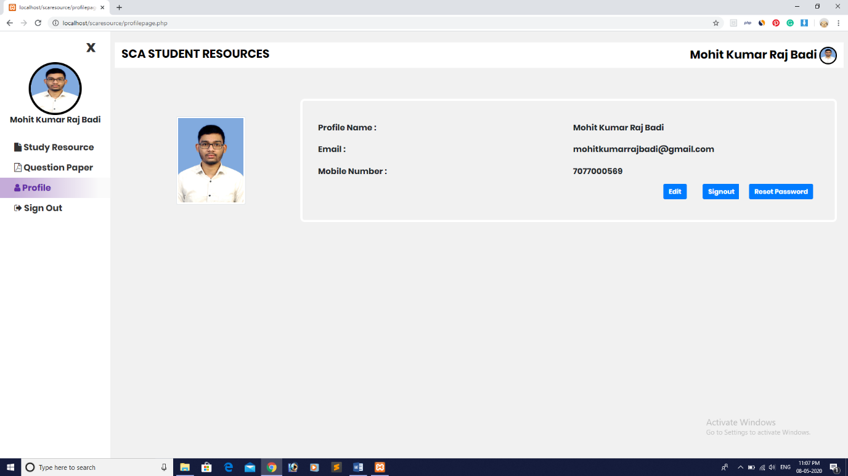
Use the Study Materials:
Use the Exam Files:
Manage own Profile:

Slide 32
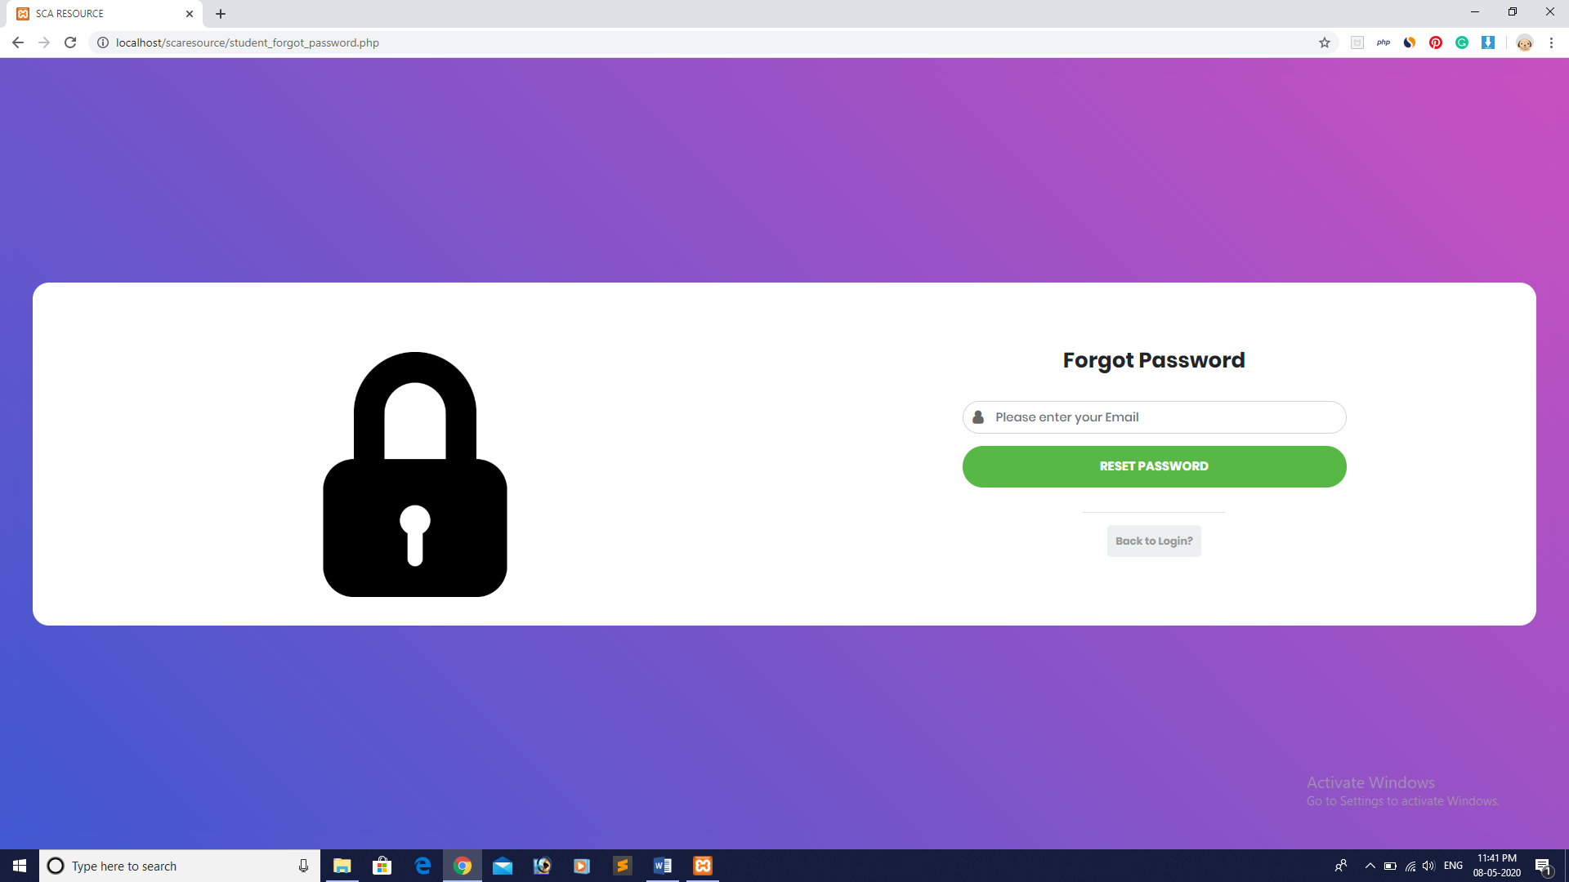
(Student/Faculty/Admin) Forgot Password / Reset Password:

Slide 33
Test case
Student Login Page:

Slide 34
Faculty Login Page:
Admin Login Page:

Slide 35
Student Dashboard:
Faculty Dashboard:

Slide 36
Sl.No. | Test Case ID | Do | Expected Result
01. | QT6-001 | Click on open menu button | Successful open Side menu.
02. | QT6-002 | Check links on Admin dashboard | Successful redirected to the specified page
03. | QT6-003 | Click on Pending Approval Link | Successful redirected to Pending Approval Link
04. | QT6-004 | Check Permission Accept/Deny button | Successful working permission buttons
05. | QT6-005 | Click on View File | Successful redirected to view file page.
06. | QT6-006 | Click on Approved Student Link | Successful redirected to approve student page.
07. | QT6-007 | Try to edit student Profile | Successful edited profile.
09. | QT6-009 | Try to delete Student Profile | Successful delete profile.
10. | QT6-010 | Click on Denied Student Link | Successful redirected to Denied student link.
11. | QT6-011 | Try to give permission/delete profile | Successful permission and delete profile
12. | QT6-012 | Click on Faculty Link | Successful redirected to Faculty Page
13. | QT6-013 | Try to edit Faculty Profile | Successful edit Faculty Profile
14. | QT6-014 | Try to delete Faculty Profile | Successful delete Faculty Profile
15. | QT6-015 | Try to add Faculty Profile | Successful add Faculty Profile
16. | QT6-016 | Click on Subject Link | Successful redirected to Subject Page
17. | QT6-017 | Try to edit Subject | Successful edit Subject
18. | QT6-018 | Try to delete Subject | Successful delete Subject
19. | QT6-019 | Try to add Subject | Successful add Subject
20. | QT6-020 | Click on Admin Link | Successful redirected to Admin Page
21. | QT6-021 | Try to edit Admin Profile | Successful edit Admin Profile
22. | QT6-022 | Try to delete Admin Profile | Successful delete Admin Profile
23. | QT6-023 | Try to add Admin Profile | Successful add Admin Profile
24. | QT6-024 | Click on Files Link | Successful redirected to Files Page
25. | QT6-025 | Try to edit Files | Successful edit Files
26. | QT6-026 | Try to delete Files | Successful delete Files
27. | QT6-027 | Try to add Files | Successful add Files
28. | QT6-028 | Click on Exam Files Link | Successful redirected to Exam Files Page
29. | QT6-029 | Try to edit Exam Files | Successful edit Exam Files
30. | QT6-030 | Try to delete Exam Files | Successful delete Exam Files
31. | QT6-031 | Try to add Exam Files | Successful add Exam Files
32. | QT5-032 | Click on Profile Link | Successful open of Profile Link.
33. | QT6-033 | Try editing Profile | Successful edit Profile
34. | QT6-034 | Click on Reset Password Link | Successful redirect to reset password link.
35. | QT6-035 | Click On Logout Link | Successful Logout
Admin Dashboard:

Slide 37
Student Reset/Forgot Password:
Faculty Reset/Forgot Password:

Slide 38
Admin Reset/Forgot Password:

Slide 39
Pros of system:
Easy accessibility. It can be accessed from anywhere at any point in time.
Can be accessed from any OS platform like Windows, Mac OS, Android, etc.
Used through a browser.
Effective and efficient way of resource sharing.
Safe and Secure resource sharing/storing.
Reduce the work of the Faculty Members and Students too.

Slide 40
cons of system:
ID and password can be used by some other person who is not authorized.
The system is highly secured but hackers can hack it and manipulate the system.
Student can download the resources and use it and manipulate it which can be against the rules.
Some faculty members resource can be used by others which is against the copyright.
May lead to copying resources or pilgrims.

Slide 41
FUTURE SCOPE
As website development doesn’t have any end, hence this project has a very good scope for adding new features in the near future. We can add new features as and when we require. Reusability is possible as and when require in this application. There is flexibility in all the modules.
So we can enhance the following service:
Add e-Library to the module.
Add more security.
Add Forum and Live Chat Features.
SMS acknowledgement.
Video study materials.
Can be converted to Study resource Marketplace.
Add Tutorials from different faculty members.

Slide 42
CONCULSION
The project SCA Study Resource Management System is for simplifying the study and exam resource storing/sharing process.
The software takes care of all the requirements for sharing and storing the resources and is capable to provide easy and effective storage of information.
This system has its advantages and disadvantages but it can surely help with the resource storing/sharing process.

Slide 43
BIBLIOGRAPHY
Books
Software Engineering – A Practitioner’s Approach, Roger S. Pressman; McGraw-Hill International Edition.
Software Engineering, Sixth Edition, 2001, Ian Somerville; Pearson Education.
The Complete Reference: PHP & My SQL.
URLs
https://www.w3schools.com/
https://www.tutorialspoint.com/php/

Slide 44
Thank you

